Slide 1

Data Visualization Using Tableau
Curtis Lo

Slide 2
Project Flow Structure
Connect the data source
Establish relationships/joins
Establish a visual for necessary data
Create dashboards for summary
Summarize findings
Challenges

Slide 3
From The Data
Housing price index vs. benchmark prices
Housing vs. Office Trend
Which one is getting more expensive, faster?

Slide 4
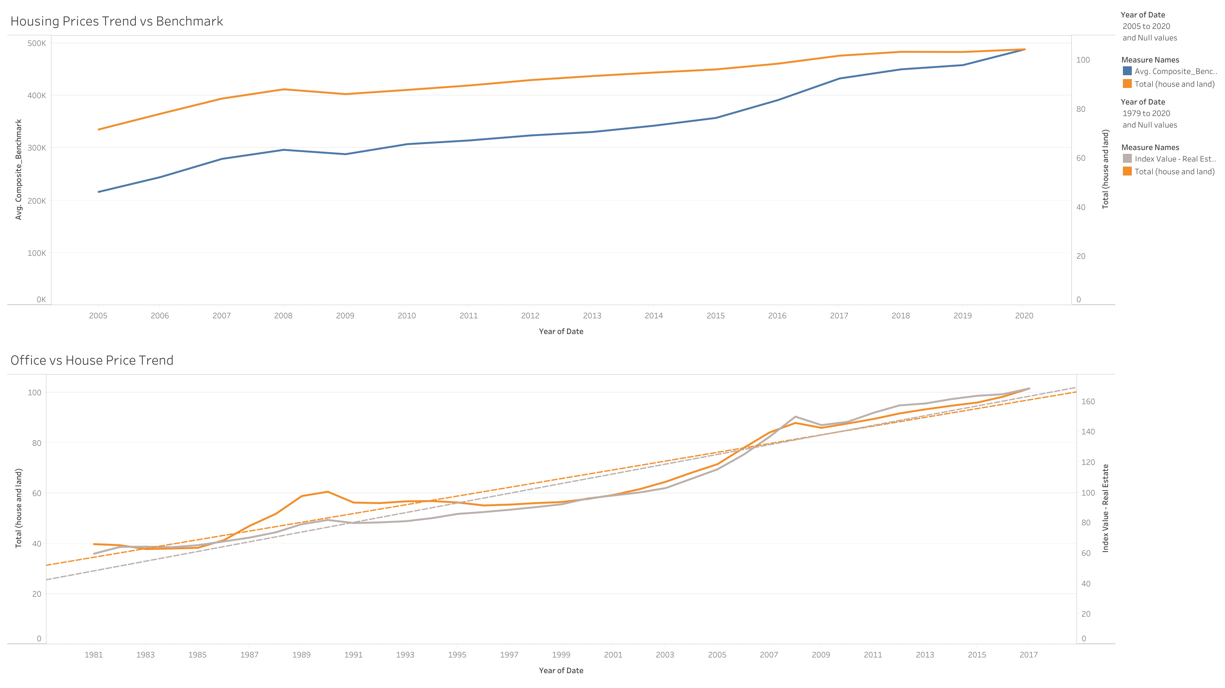

Slide 5
From The Data
Heatmap
Are the price differences between different districts increasing?

Slide 6
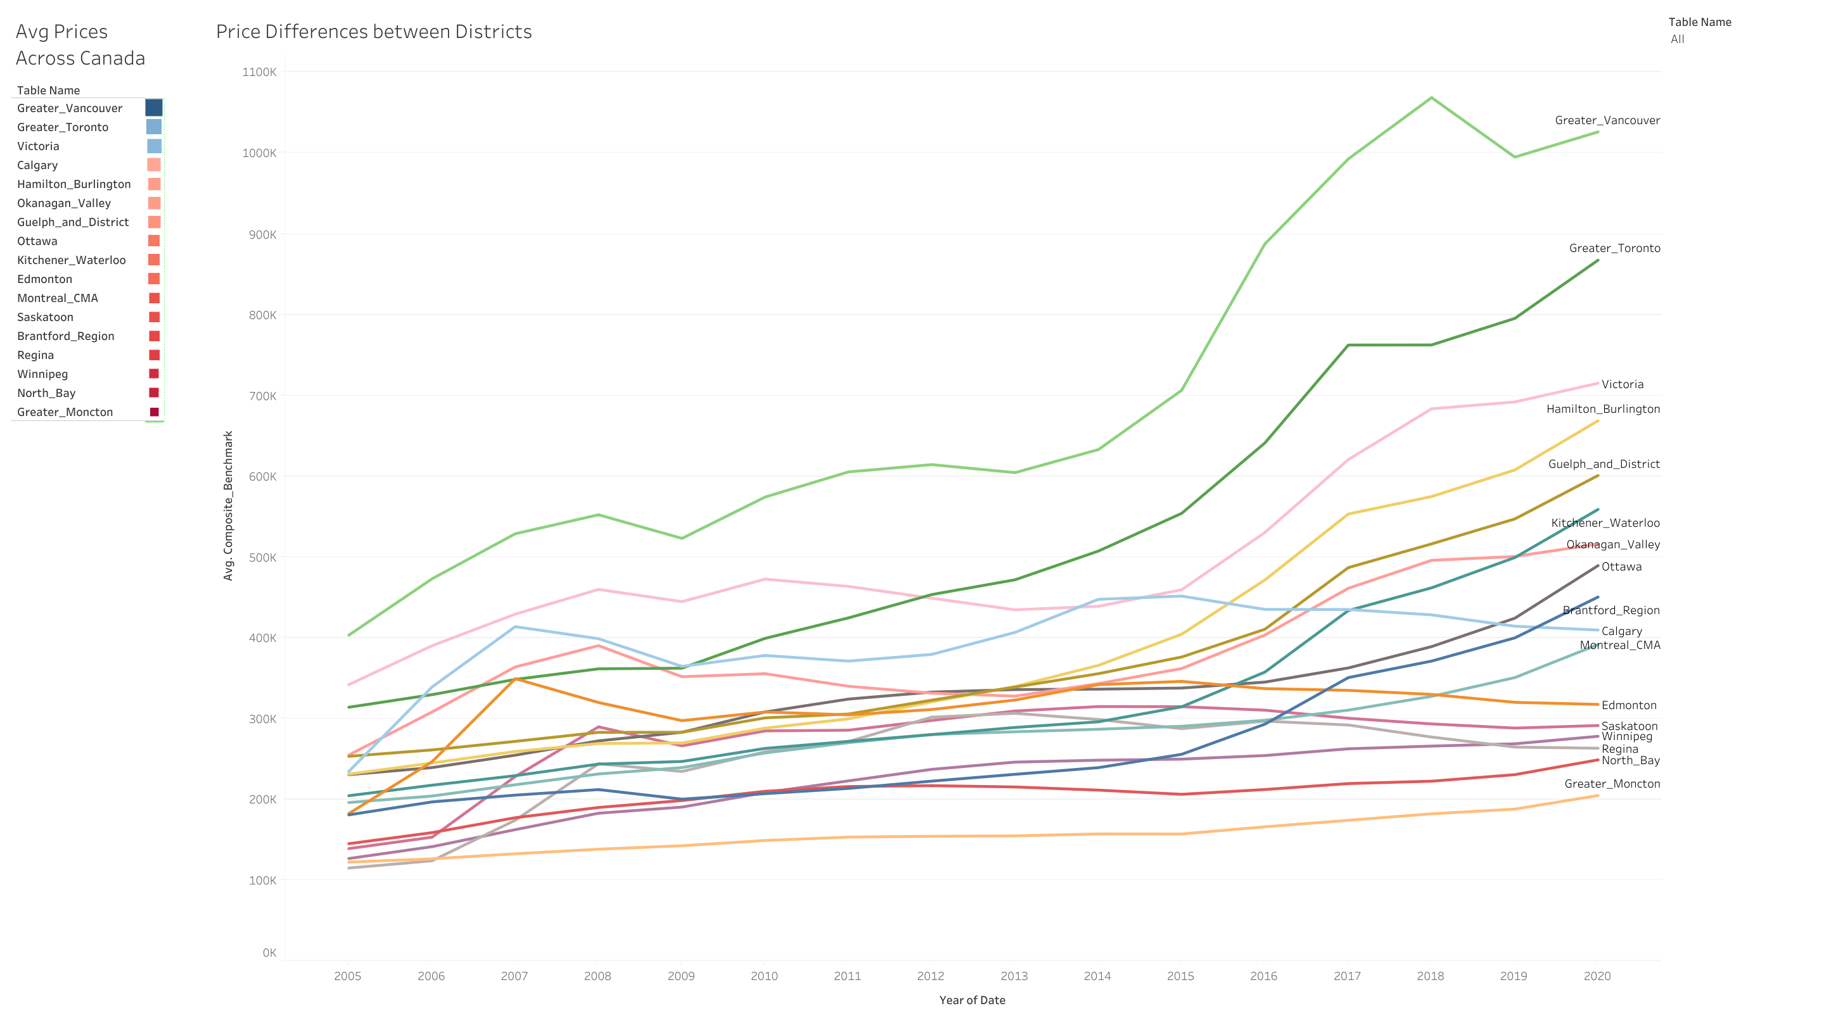

Slide 7
From The Data
House prices vs earnings
Did people spend more of their earnings in 2014 than in 2001?

Slide 8
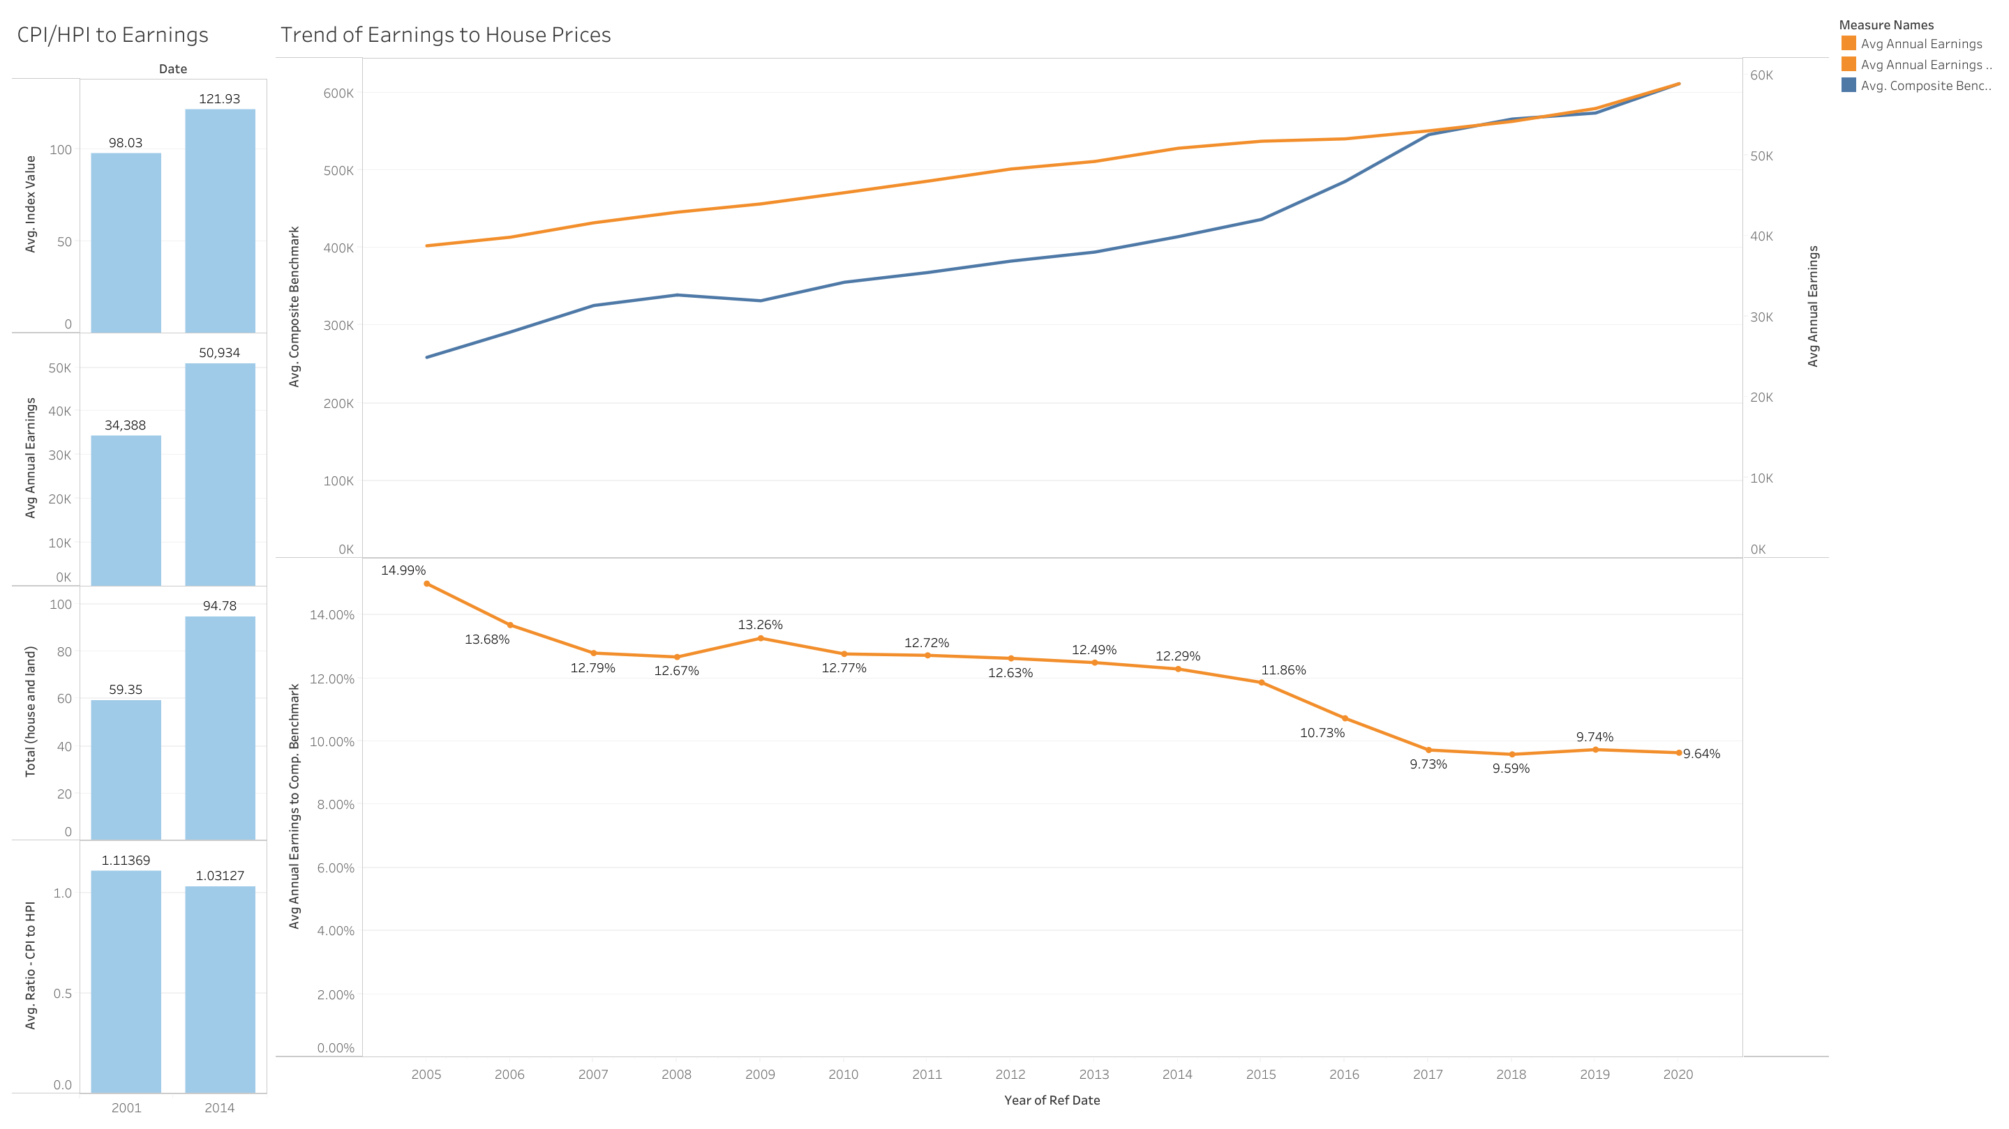

Slide 9
From The Data
Effect of crises
CPI/HPI
Predict CPI from HPI?

Slide 10
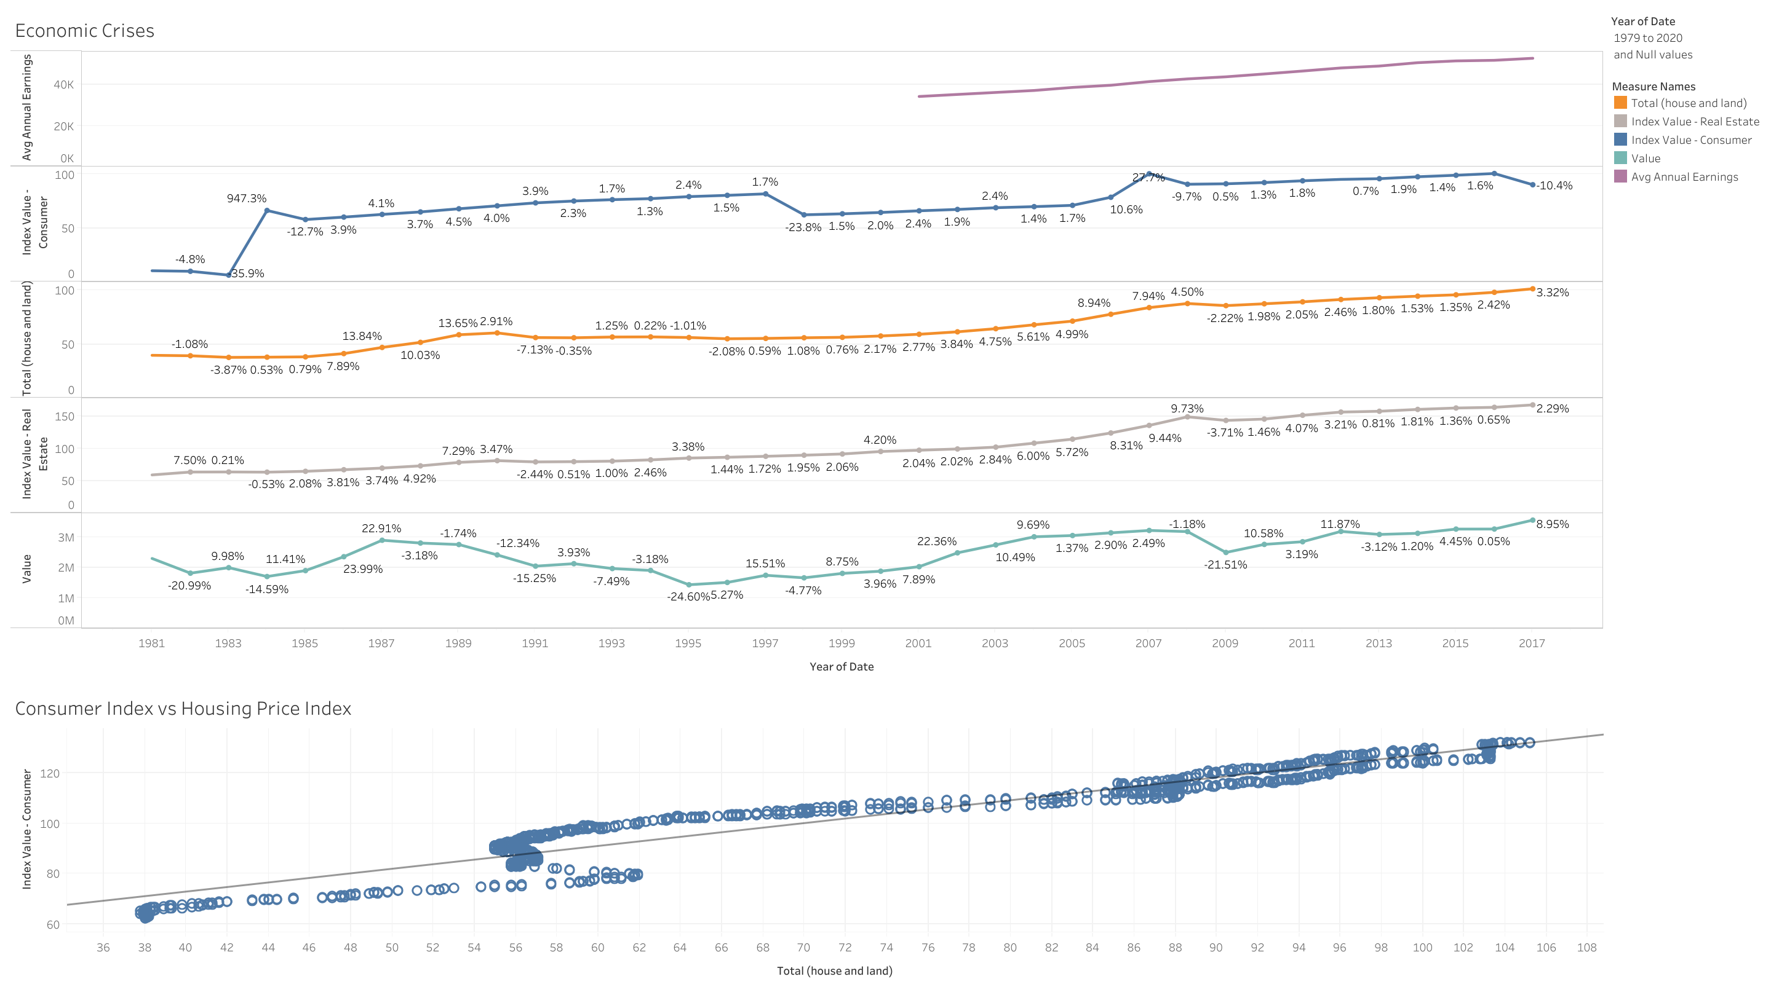

Slide 11
Final Thoughts
Challenges
Overthinking
Understanding which tables need to be joined
Selecting the proper visualizations
Compiling via Tableau Public
More time
Ensure all the charts/graphs align with each other (filters on dashboards link properly)
Match units for a better apples-to-apples comparison (e.g. units of measurement, indices, etc…)
Use different variations of graphs
Identity specific points/trends on the visual to tell a better story
Explore using Tableau Story

